Slide 1
SUPERVISED CONTRASTIVE LEARNING

Slide 2
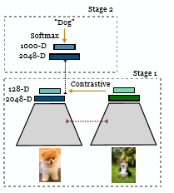
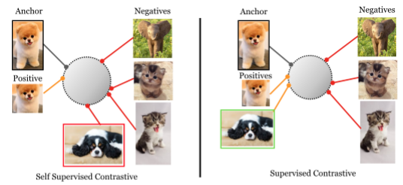
Proposed Method:

Slide 3

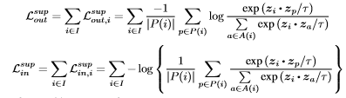
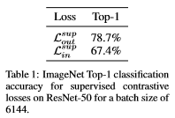
Contrastive Loss Functions:
Self-Supervised Contrastive Loss:
Supervised Contrastive Loss:

Slide 4


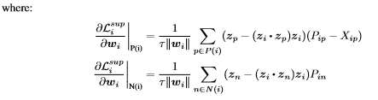


Intrinsic Hard Positive and Negative Mining Properties:
For an easy positive:
For hard positive:

Slide 5
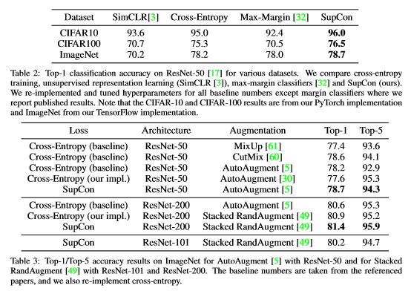
Classification Accuracy:

Slide 6
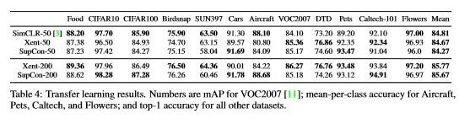
Transfer Learning Results:

